Slide 1
Bank Loan Defaulter Prediction
Presented by:
Ahmad Alharthi
Faisal Alsufyani
Yahya Alyoubi Instructor: Dr.Mejdal Alqahtani

Slide 2
Introduction
Financing is a credit method that enables the client to borrow a certain amount of money to achieve his financial goals, and the client may stumble in paying the installments as a result of a sudden change in his financial situation or mismanagement of benefiting from financing and not allocating part of the income to pay the installments.

Slide 3
Goals
The goals of the project:
This project aims to classify a customer whether a loan defaulter or not based on multiple factors like loan amount and Interest Rate.
Finding the factors that affect clients' failure to pay the loan before obtaining it with high accuracy.

Slide 4
Penalties
Penalty for defaulting on loans:
Difficulty obtaining another financing shortly.
Legal accountability and prosecution by creditors.
Freezing bank accounts.

Slide 5
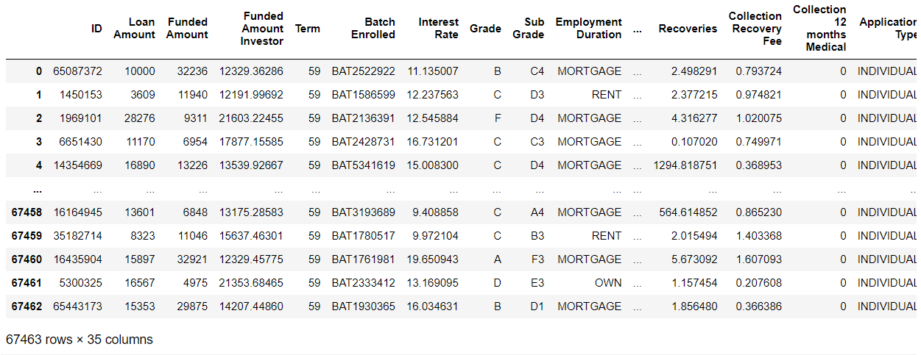
Data Structure
This data set was collected from Kaggle.com website
This is a simple overview of the data structure, in which the names of the columns and some rows are explained Columns 35 Rows: 67463 Before cleaning the data :

Slide 6
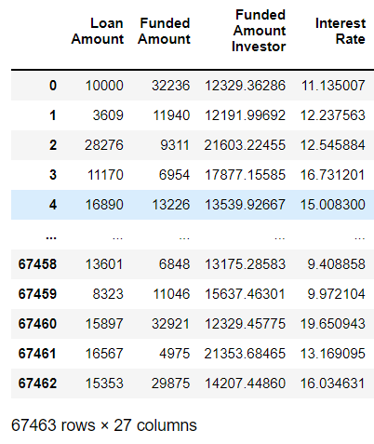
Exploratory Data Analysis
Delete columns
Duplicate values
Check for NaN values

Slide 7
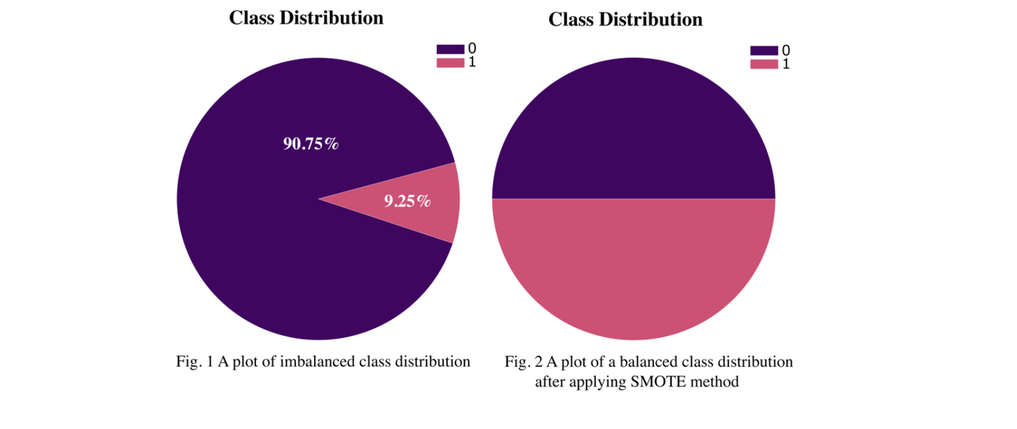
Exploratory Data Analysis

Slide 8
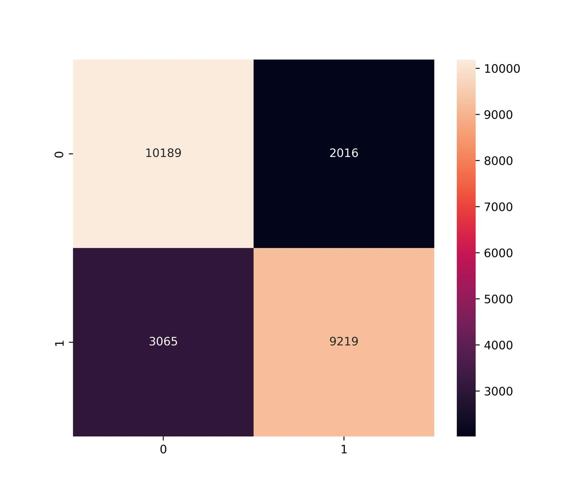
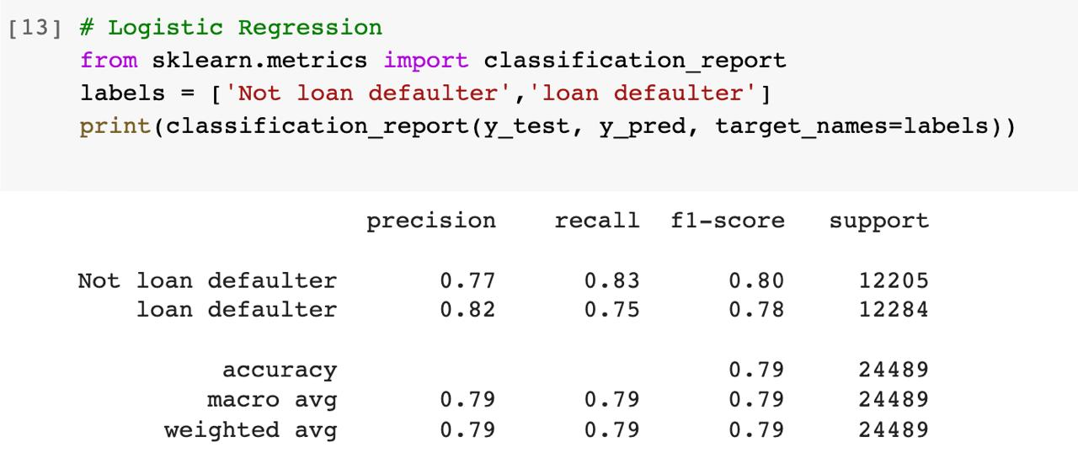
Logistic Regression

Slide 9
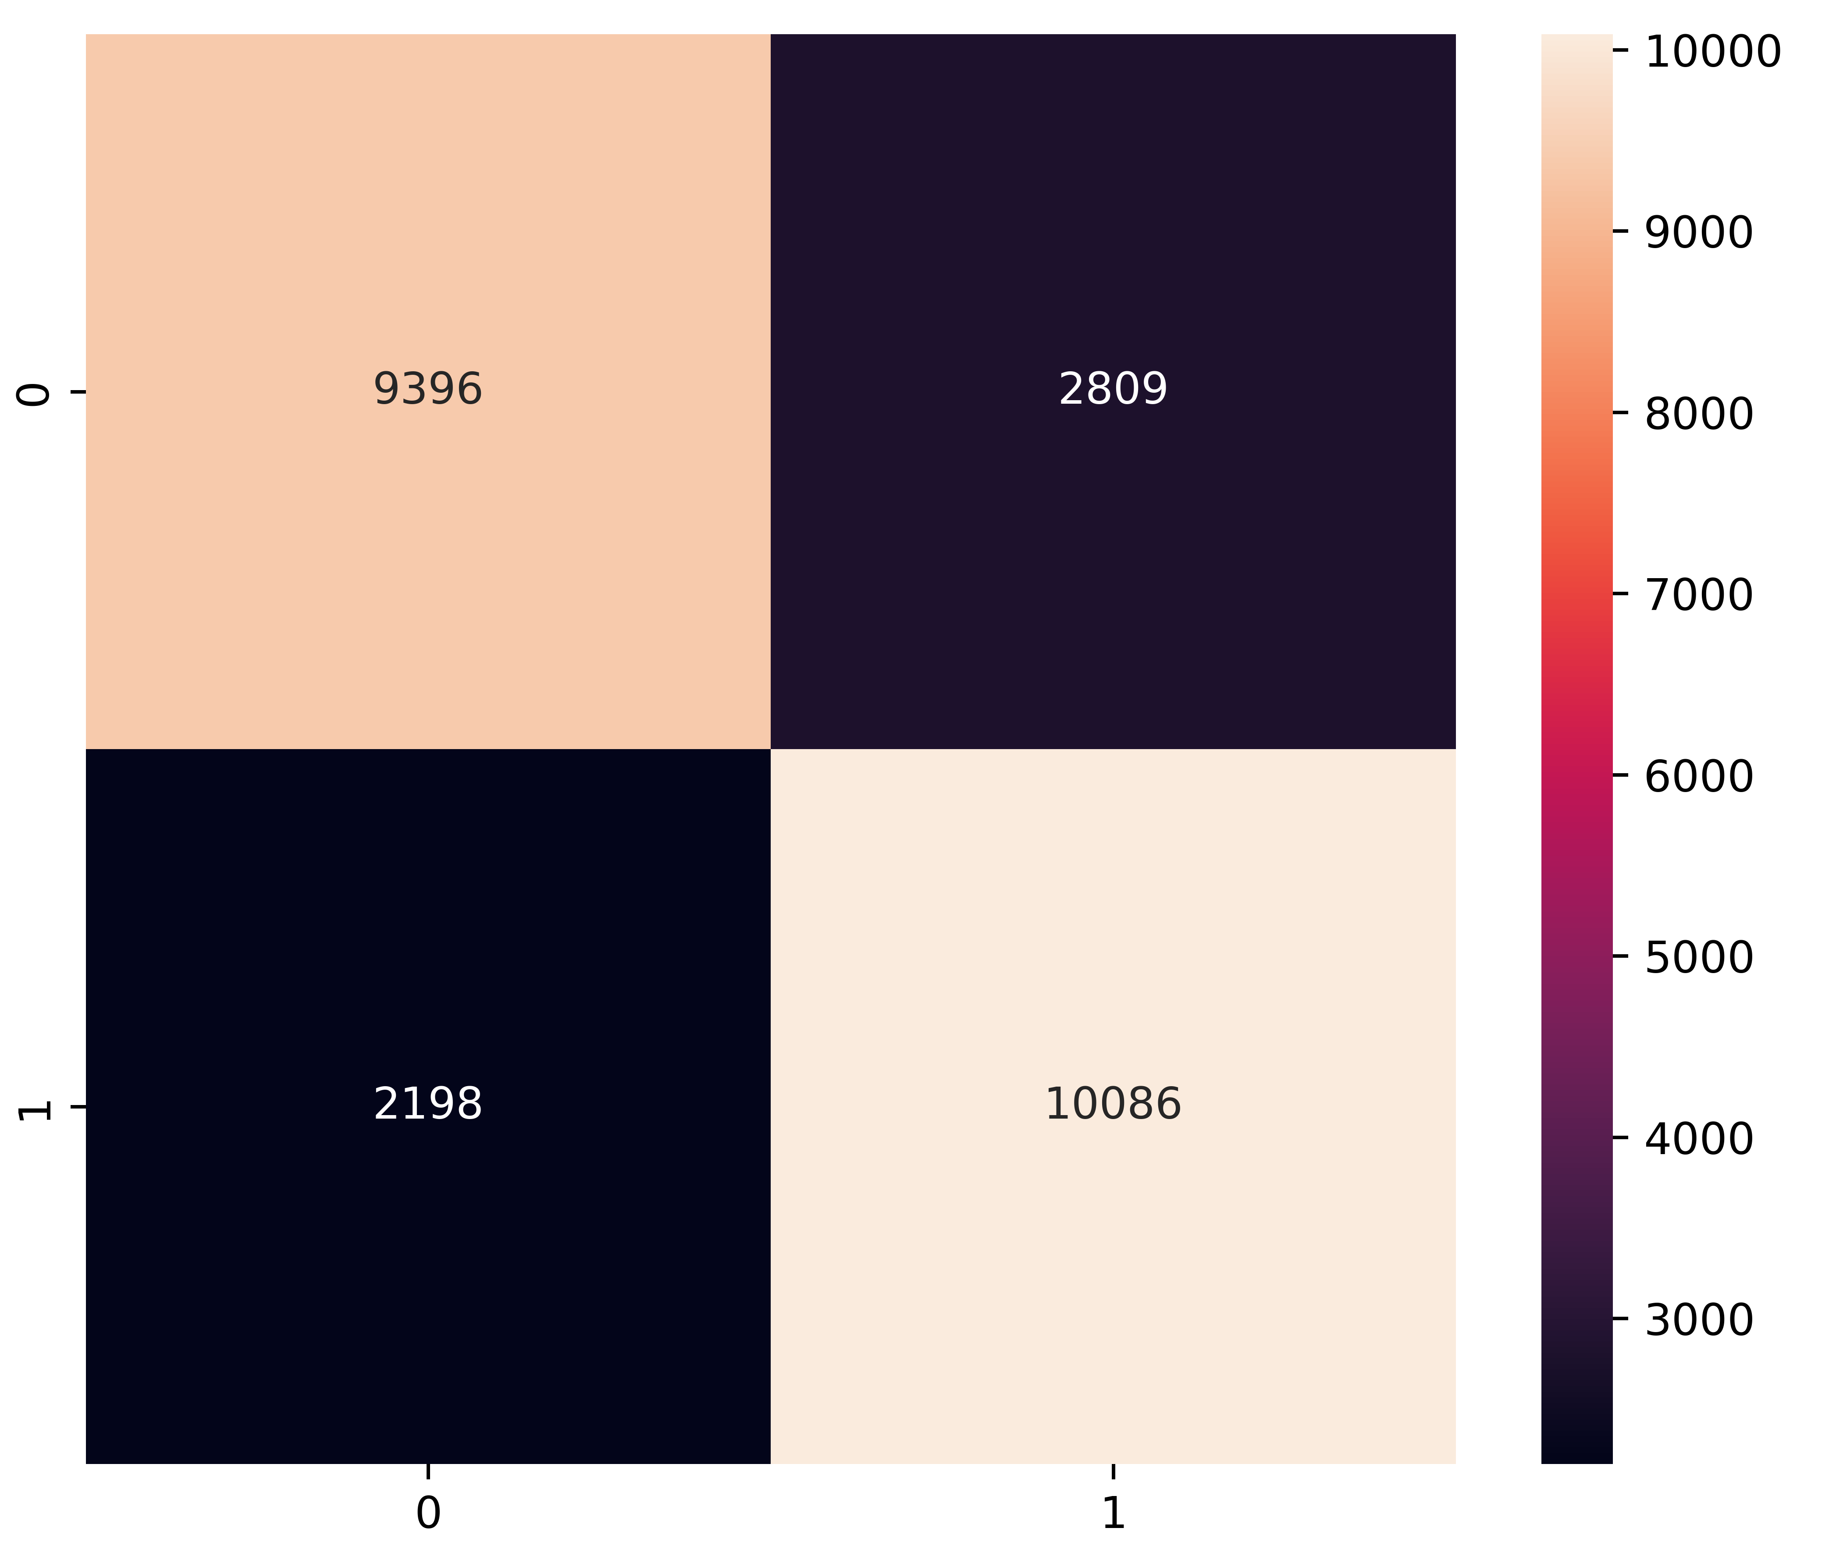
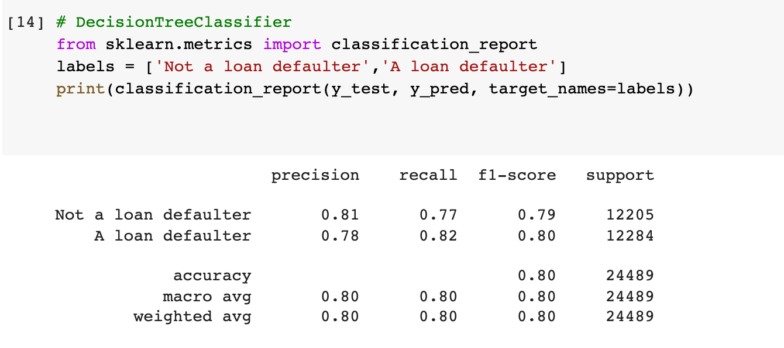
Decision Tree Classifier

Slide 10
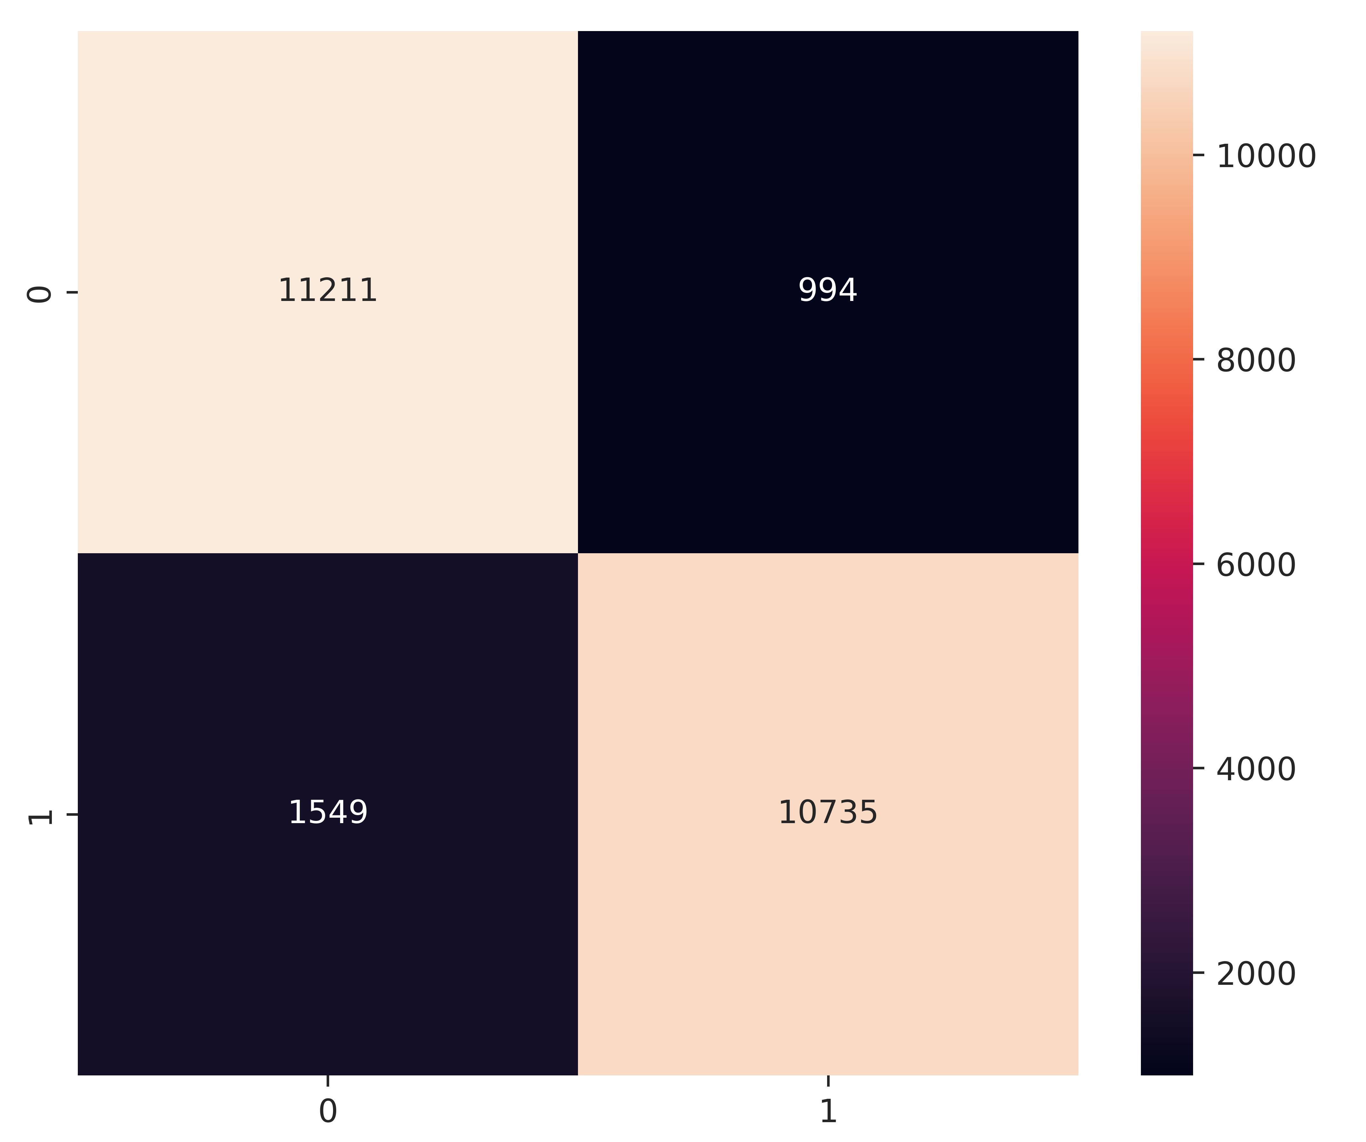
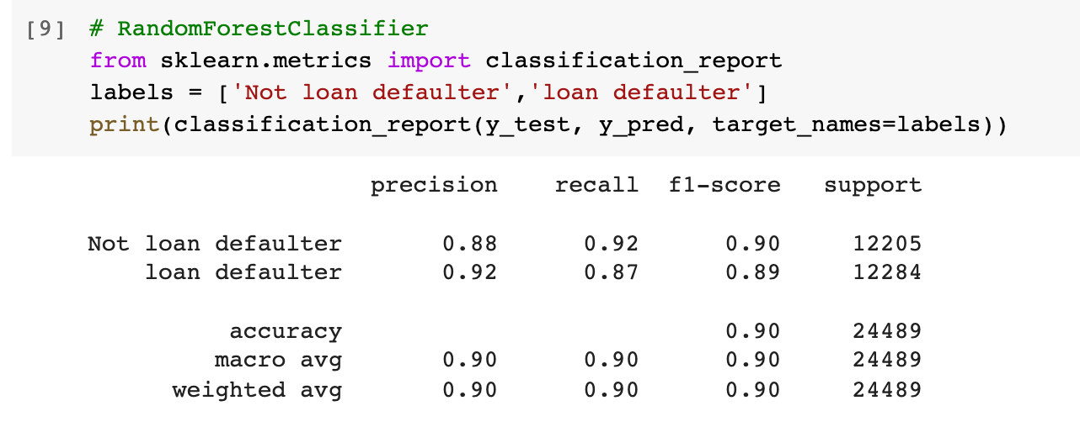
Random Forest Classifier

Slide 11

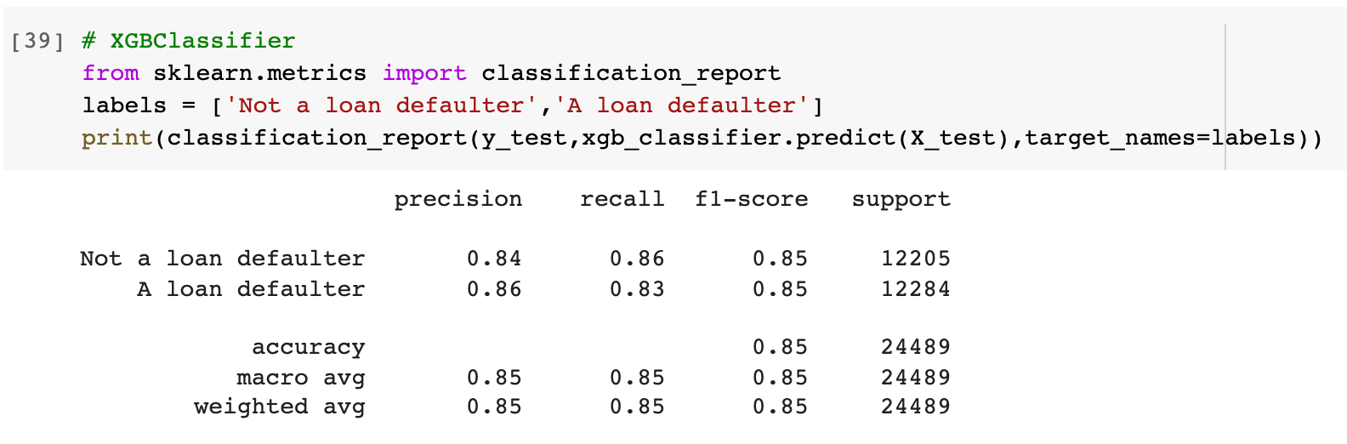
XGBoost Classifier

Slide 12
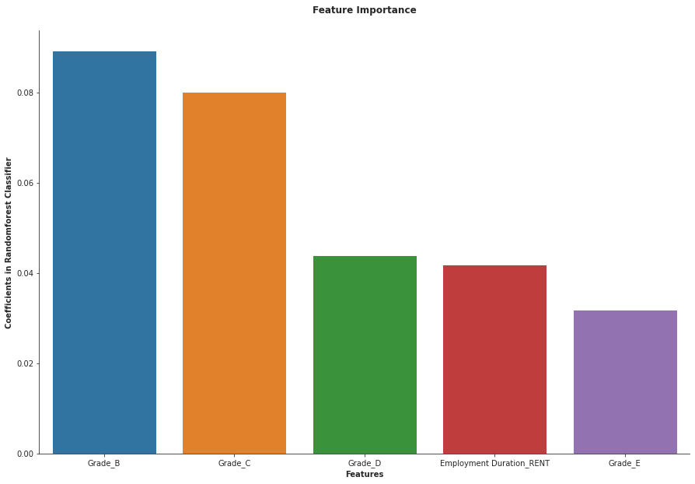
Conclusion & Future Work
Model Selection
Random Forest Classifier
- with precision which 92% and recall 87%
Able to predict the person who might be a loan defaulter
Feature generation needed to improve the accuracy

Slide 13
Thank You
Any Question ?

